Slide 1

LOSS Team Volunteer Information Session
Suicide Prevention Program
Lewis and Clark Public Health

Slide 2

Suicide Language
  Talking about mental health and suicide are important to destigmatize these topics
  How we talk about it can add or decrease stigma
  Avoid:
  Commit
  Success/unsuccessful

Slide 3
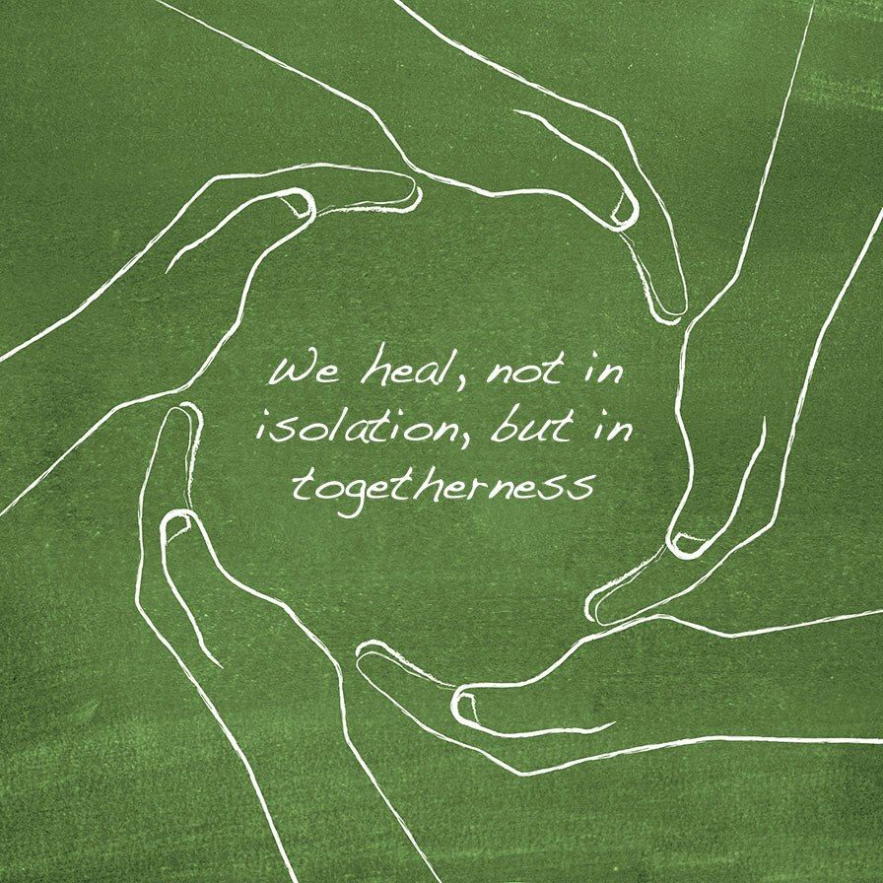
What is a LOSS Team?
Local Outreach to Suicide Survivors (LOSS) Team
Teams go to the scene of confirmed suicides following notification from law enforcement or the Coroner’s Office
Made up of community members who have lost a loved one to suicide & behavioral health professionals
They provide:
  Support peer survivors. “I lost someone too.”
  Hope for life after loss. “You won’t always feel this way”
  Resources to stabilize, process and eventually grow.

Slide 4

LOSS Team beginnings
Created in 1999 by Dr. Frank Campbell to help survivors
We are the light house in the storm, guiding ships to port
Evidence-based for connecting/engaging survivors to support services quickly
40 teams across the U.S. & several international locations
Notes:
Light house in the storm – lighthouses don’t exist for calm waters and sunny days. They’re here to guide the way during a moment of chaos and difficulty. It’s the same with the LOSS Team.
Frank is a past president of the American Association of Suicidology and runs a clinic in Louisiana. That’s where he started LOSS Team, after realizing that survivors were dying by suicide

Slide 5

Suicide loss is traumatic
Intense emotional pain, and shock. “Why?”
Whirlwind of emotions: anger, shame, grief, confusion, hopelessness, self blame, denial, relief
What does this say about me, about my family?
Sometimes in such pain they want to join loved one
Concern about burial rights, sin and afterlife for the loved one who passed
Family may be shunned by church, friends or friends don’t know how to help
Stigma, stigma, stigma
Support can be hard to find

Slide 6
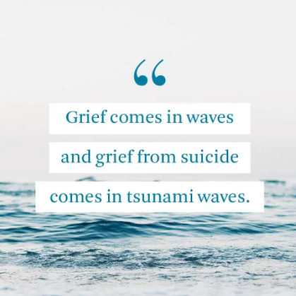
Why LOSS Teams matter: Survivors need extra support
Because of many of the reasons on the previous slide, they aren’t getting the help they need
Can get stuck in the early, most painful stages of grief
  Can develop substance use, hoarding, other unhealthy behaviors to cope
  3x higher risk of suicide

Slide 7
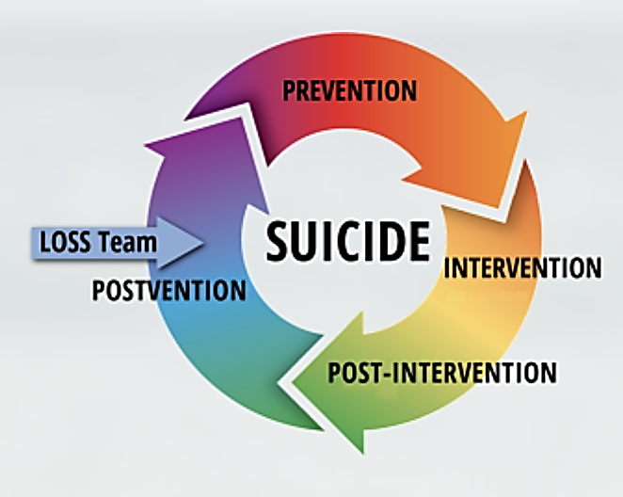
Postvention is prevention
Suicide postvention refers to an organized response in the aftermath of a suicide to facilitate healing associated with the grief and distress of suicide loss
Reduces likelihood of suicide contagion & additional suicides
Mitigates the impacts of a loss
Facilitates healing
But most postvention services require survivor awareness to access
Active postvention eliminates “the stumble effect”
Drops typical service connection From 4.5 years to 39 days
Notes:
The stumble effect refers to someone stumbling upon survivor services at a resource fair or other activity. They don’t generally know they exist until that occurs. LOSS Team removes the stumble by delivering information directly to survivors by those who have been “there” too.

Slide 8

LOSS Team of Lewis and Clark County Area
First LOSS Team in Montana
Subgroup of Lewis and Clark Suicide Prevention Coalition, overseen by Lewis and Clark Public Health staff
Funded by annual DPHHS grant
Partnership with LCSO coroner’s office, which notifies the team of a confirmed suicide
Leadership group of key stakeholders
Consultant assisting with training
Launched April 9, 2022
Hope to inspire more teams across the state
https://www.youtube.com/watch?v=gFBSjQknmlw&t=8s

Slide 9

Services provided
Delayed response – survivor contact within 24 hours of notification; visits based on survivor availability
Connection to services during visit and regular follow up calls
  1 week, 1 month, 3 months, 6 months, 9 months & 1 year
  Calls to show care, assess suicidality, connect to services, ID other survivors
Two free sessions with a grief counselor via partnership with Awareness Network
Survivors who haven’t received assistance can call to request a visit – 406-457-8970
  Happy to assist survivors who did not receive care before LOSS started. Not eligible for 2 free sessions if loss is older than 1 year.
Resource materials, including activity books for youth to understand suicide grief

Slide 10
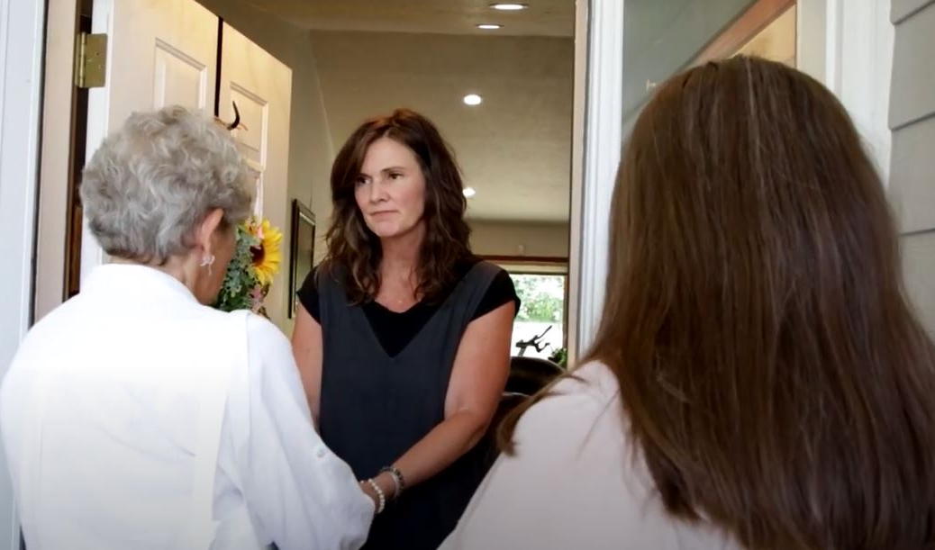
Delayed visits
Coroner’s Office uses app to fill out a confirmed suicide report
Clinical volunteer checks and then immediately calls next of kin (NOK)
If NOK wants a visit that day, clinician calls other volunteer on-duty to make travel arrangements
  If another day chosen, clinician contacts team on duty that day
Arrive to scene together
Provide resources and connection to services, hope. Discuss survivor’s experience
This isn’t therapy, also, clinicians who arrive to a particular scene won’t obtain clients from there
Debrief after
Notes:
CONNECT is a provider-to-provider referral system. Once a referral is made, providers call patients to set up appointments. This way, end users don’t have to navigate an agency’s phone system or figure out who they should contact. The right people call them.

Slide 11

Volunteer shifts
  Weekday: 4 – 8 p.m.
  Weekend: 8 a.m. – 2 p.m. or 2 – 8 p.m.
    Clinician checks email at beginning of shift. If no loss report, both volunteers are off duty. If there is a report, they call the family immediately to schedule a visit
Even on call, you can still live your life!
  Want to go to the gym? Pack a change of clothes
  Going to dinner with your family? Take two cars or have a drop-off plan
  Need a nap? Go for it, just keep that phone nearby!
  Avoid alcohol and other substances
  Have childcare back-up
  Stay in town until you get the “all clear”
Notes:
While we always want to be prepared to respond,

Slide 12
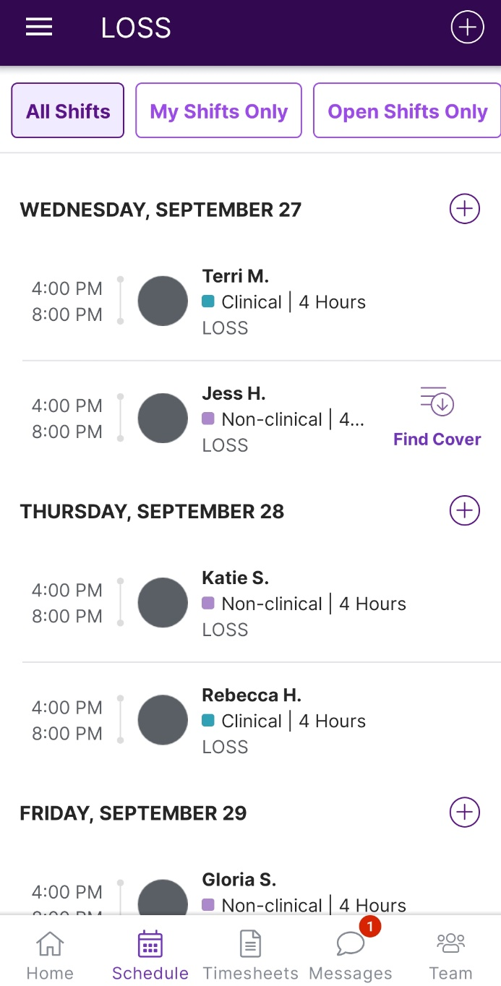
Scheduling
All scheduling and reporting can be accessed via your smart phone
Flexible – based on your schedule. You choose your shifts
Work around vacations
Clinicians can take bulk days/ weekends if they prefer
Ability to trade shifts
Chat function in Homebase to communicate with fellow volunteers

Slide 13
Volunteer support
Strict buddy system for all calls
Debriefing immediately after for non-clinicians
Clinician-to-clinician support
Catered monthly dinner meetings for learning, debriefing, problem solving together. All meals provided!
Opportunities for additional training – QPR, MHFA, YMHFA, ASIST, Grief Institute, suicide bereavement, etc.
CEUs for clinicians

Slide 14

We heal by helping others heal
Turning grief and experience into hope and action
Sense of community
Those served often join LOSS later to pay it forward
Many find unexpected healing in service to others

Slide 15

Volunteer with us!
Complete application - https://forms.gle/BkexMLXuiLnH4z9Y8
Training for volunteers, including on-scene etiquette
Background checks
Debriefing process to prevent re-traumatization
Seeking volunteers now!
  Clinicians, survivors (lived experience)
Other volunteer roles:
  Fundraising
  Stuffing bags
  Follow up calls
  Marketing
  Outreach

Slide 16

Other volunteer opportunities
Join the Lewis and Clark Suicide Prevention Coalition
Become a trainer to educate the community about mental health and suicide
Conduct outreach at events and with community groups
Help spread the word about safe storage with firearm-businesses, pharmacies and the general public
Assist with planning the annual Tri-county Out of the Darkness Campus Walk or help on the day of!
Notes:
Opportunity to volunteer instead or in addition to LOSS

Slide 17
Other grief resources
Helena Area Suicide Bereavement Support Group
  Fourth Tuesday at 6:30 p.m. at the St. Peter’s Health
  Call Gloria (406) 545-8645
Charlie Health’s Online Suicide Loss Support Group
  Virtual support group meets first and third Fridays at 12 p.m. https://bit.ly/charliehealthsupport
Tamarack Grief Resource Center
  Grief Support Groups, grief counseling, webinars, grief camps
  Call (406) 541-8472
Healing Conversations
  Gives survivors the opportunity to speak with volunteers, who are themselves loss survivors. Learn more at http://pos.li/2h1q4e
Tragedy Assistance Program for Survivors (TAPS)
  If you’ve lost a family member, loved one, colleague, friend, or battle buddy to suicide (either during or after their military service). TAPS offers a grief counseling, peer mentor programming, online chat, suicide survivor seminars and more. Call 800-959-8277
Helena Vet Center
  Offers six free sessions with a therapist if you are military-connected
  406) 457-8060

